Slide 1
Online Safety Information

Slide 2

The app, in some ways, is much like Musical.ly, the so-called “global video community” that allows users to create, share, and explore short music videos. But Like takes things a step further with a number of augmented reality effects, resulting in what the Like team calls “music magic.”
Within the app users can search for videos in 2 ways, either by viewing trending videos at the time or browsing the most recently uploaded videos (This is a feature not available in musical.ly). There are no age restrictions in terms of what videos users can see. For example an adult can view the videos uploaded by a child.
In line with the majority of apps, users can be rewarded with likes and an inbuilt messaging system allows users to communicate privately, again with no age restrictions.

Slide 3

Instachat
Instachat is a place that pairs random users in one-on-one sessions for video and text chat conversations.
There is no requirement to register - the users are completely anonymous! Although predominantly used for video chat there is an option to use the chat box to message each other while video chatting.
It has an age rating of 17 and the app store which states there is frequent/ Intense Sexual Content or Nudity.
The app is very similar to random chat sites such as Chatroulette, Omegle, Chatrandom and Tinychat alternative. As with the majority of these apps, they have a legitimate use for connecting people from around the world, however they are misused by a select group of individuals.

Slide 4

Skinseed for Minecraft Skins
Skinseed is an app that allows users to create importable skins for the minecraft game, both the PC and pocket edition of the game.
The game has an embedded community where skins can be shared with friends before uploading to the game.
Case Study
A young girl has been involved in some very explicit role play conversations revolving around the character she created. No nudes were requested however within the forum lots of Hentai images were shared.
Henthai is a word of Japanese origin which is short for a perverse sexual desire. English adopts and uses hentai as a genre of pornography by the commercial sale and marketing of explicit works under this label.

Slide 5

The party in my Dorm (PIMD) app is designed as an all-encompassing social networking game for over 17 year olds.
The aim of the game is to grow your dorm into the best one on campus. This is done through increasing your avatars status and showing off to your friends through trading items and in game currency. The account can be linked to Facebook and snapchat accounts.
Case Study
A 9 year old female joined the online game having heard of it through a friend. Within minutes of setting up her profile she had 10 friends on the site and in addition to this she had requests through snapchat, Facebook and WhatsApp for indecent images, at which point she reported it to her parents. The father of the victim described the communication as very sexually explicit.
This raises the need for young people and parents to be aware of linking multiple social media accounts together and the privacy options of such profiles are set to private.

Slide 6

Chatrandom is a live streaming website much like the popular sites omegle and chatroulette. The website matches two random people via webcam to make new friends, however this can be exploited in many ways. The case study below is an example of how young people are being exploited on the site.
Case Study
A 16 year old boy was on the website looking to make new friends and noticed a girl who he thought was attractive and started talking to her. After a while the female asked if he could contact her on Skype, which he agreed to do.
During the skype call the boy has been asked to expose himself, which he has done. A recording of the video call was subsequently sent to the boy with a message stating if he did not pay £1000 to a named account then the video would be sent to friends and family, which were named in the message (names believed to have been taken from victim’s public Facebook account).
The boy began to receive messages on his mobile asking for the money and under duress the boy paid £800 to the unknown account. Investigations are ongoing.

Slide 7
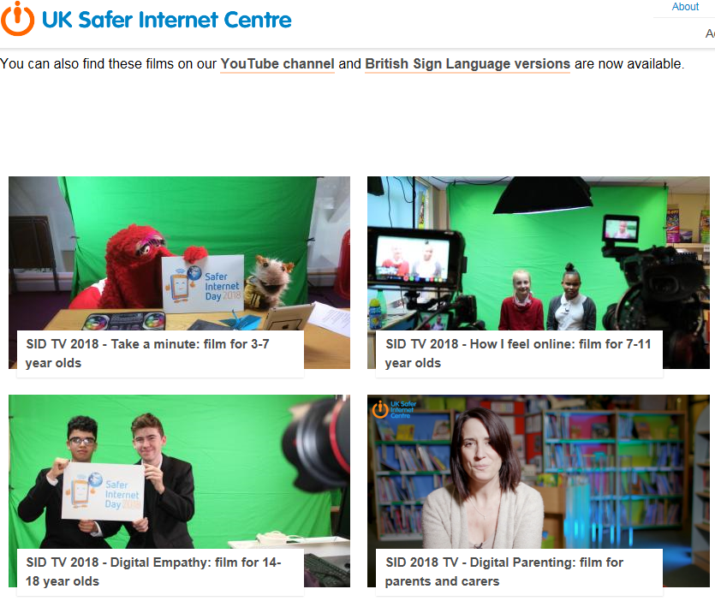
https://www.saferinternet.org.uk/blog/4-ways-schools-can-get-involved-safer-internet-day?utm_content=bufferbf763&utm_medium=social&utm_source=facebook.com&utm_campaign=buffer

Slide 8



ChildLine and the Internet Watch Foundation have come together to provide a service where children can request the removal of sexual images of themselves which have been shared online. As part of that process the child would be asked to provide a link to where the image is stored online, rather than send the image itself.
The child is also required to verify their identity and age and this is done through the YOTI app. YOTI will not store images of the child’s ID following the verification process.
Below are a couple of online resources which contain details regarding this service:
https://www.nspcc.org.uk/preventing-abuse/keeping-children-safe/sexting - There is a section which covers what you can do if you’ve lost control of a sexual image and refers to the YOTI app.
https://contentreporting.childline.org.uk – This is the portal where you can report images and videos for take down and again refers to using the app to verify age.

